Slide 1
GAMECO: Sales Insights
Lisa Coombs
March 29, 2024

Slide 2
Current Understanding
GameCo intends to allocate marketing funds to the highest grossing markets. This deck will offer insights on market trends and top performing game genres that may indicate alternative ways to drive sales.

Slide 3
Insights:
Due to Covid-19, sales in North America and Europe were driven by a shift to digital distribution and growth in mobile gaming due to installation of 5G (USA). Video games offered points of social connection as well, as online gaming provided multi-player experiences.
In Japan, Sony and Nintendo continued to dominate the market as home consoles and handheld devices, like the Nintendo Switch, gained popularity across a broad spectrum of gamers; from the casual to the hard-core gamer, young and old alike.

Slide 4
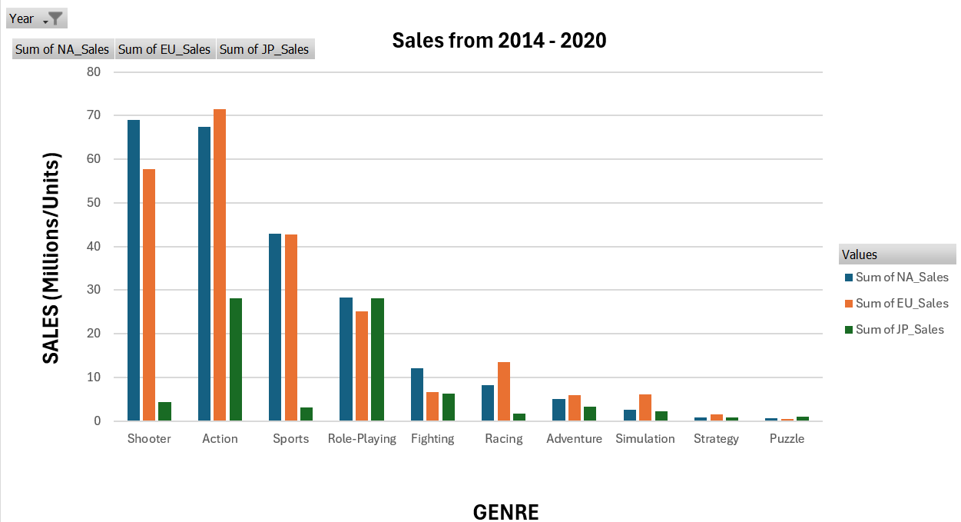
Insights:
The top three game genres are Action, Shooter, and Sports
Of the top ten genres, Strategy and Puzzle games are among the lowest performing genres.

Slide 5
Launched in 2000, Sony’s PlayStation remains the top-selling console of all time.
Insights:
Each market has a PlayStation console in at least one of the top three:
Europe – PS4, XOne, PS3
North America – PS4, XOne, X360
Japan – 3DS, PSV, PS4

Slide 6
Revised Understanding
Market Review
75% of market funding should be allocated to game development as follows:
- North American Market: game development for PlayStation PS4 and Microsoft XOne in the Shooter and Action genres
- European Market: game development for PlayStation PS4 and Microsoft XOne in the Racing and Shooter genres
- Japanese Market: game development for PlayStation and Nintendo 3DS in the Role-Playing genre

Slide 7
RECOMMENDATIONS
The remaining 25% of marketing funds could be allocated to game development in the Strategy and Puzzle genres. Although these two genres had the lowest sales in all three markets, these types of games offer benefits beyond entertainment.
GameCo could partner with school districts where student performance has been below average. Moreover, GameCo could partner with organizations like the Dementia Society of America.
Marketing can use this idea of partnering with school districts and national organizations to promote Puzzle and Strategy games for cognitive development across a broad range of age groups. Performance could be monitored for one year to see how well these types of games are doing.
Game development for PlayStation PS4, XOne, Nintendo 3DS
13% of Budget to Puzzle games
Children: contribute to problem solving, critical thinking, pattern recognition and memory enhancement
Teens: offers stress relief and cognitive development
Adults: strengthens neuroplasticity and creativity
Older Adults: augments memory and cognitive agility
12% of Budget to Strategy games
Children & Teens: enhances problem solving skills
Adults: reinforces cognitive flexibility

